Slide 1
Requirements Engineering
Elicitation

Slide 2
Activity: Interview Simulation Round 2
The class will still interview the professor on Faculty Loading (assignment of courses to teach).
The students will be grouped in pairs. An interviewer and a coach.
Classroom setup: Half-moon

Slide 3
Activity: Interview Simulation Round 2
Before the simulation (as a pair):
Write down your goals for the interview. What do you want to know about the client & the problem at hand?
Prepare 3 initial questions. Write why you would want to ask those questions. What information will you get from those?

Slide 4
Activity: Interview Simulation Round 2
During the simulation (round-robin):
Interviewer
Asks one of the questions they prepared OR a follow up question.
Coach
Uses the rubric to assess how their partner is doing in the interview.
Notes down observations, comments & suggestions on how their partner can improve.

Slide 5
Requirements Elicitation

Slide 6

We need to be able to…
Investigate the problem/s to be solved.
Cause (why it happens?)
Symptoms (how do we know it happens?)
Impact (what happens as a result?)
Describe the features
and functionalities
that will solve the
problems.

Slide 7

Common Problems & Difficulties
Domain Knowledge is not easily accessible
People find it difficult to describe expert knowledge to non-experts.
User Bias
Either they can’t or won’t tell you what you need to know
Differentiating Wants from Needs
Problem owners can lack awareness; too busy coping with the current system.
Conflicting Requirements

Slide 8
Common Techniques
Background Reading
Interviews
Surveys or Questionnaires
Participant Observation
Which of these techniques did you do for INTRODB?
What preparations did you make before conducting these elicitation methods?
What problems did you encounter? How did you solve these problems?
Are there other techniques that you performed that are not on the list?
When do we use each of these techniques?

Slide 9
Technique 1: Background Reading
What to read?
Documents, manuals, organization charts, reports, forms, documentation,…
Why bother?
Prepares you for the interview and helps you understand the process and people.
What to watch out for?
Written documents may not necessarily reflect reality.
Can take too much time and may be irrelevant.
When to use?

Slide 10
Technique 2: Interviews
Who to interview?
Every relevant user group (to get DIFFERENT PERSPECTIVES)
Why bother?
Rich collection of information (opinion, facts, feelings, perspectives, ideas)
What to watch out for?
Large amount of qualitative data to be analyzed!
Resolving conflicting information
Tacit knowledge

Slide 11
INTERVIEW: What you need to remember
Be open-minded and throw away some pre-conceived notions about what is required.
Always provided a starting point for discussion
Question
Requirements proposal
Existing System
Be mindful of organizational politics

Slide 12
INTERVIEWS: How to do it
Structured (Closed)
Predefined Set of Questions
Well-formed questions generate good answers (be clear with your objectives)
Makes it easier to analyze
( DISADVANTAGE ) Restricting in the information acquired
Non-structured
No pre-defined agenda
Good for generating new ideas (experimental, brainstorming)
( DISADVANTAGE ) Difficult to organize information
Usually it’s mixed types

Slide 13
INTERVIEWS: What to consider
Written vs. Oral?
Group vs. Person?
ADVANTAGES | DISADVANTAGES
ADVANTAGES | DISADVANTAGES

Slide 14

INTERVIEWS: Etiquette
Be prepared.
Restrict the time frame for the questioning.
ANNOUNCE estimated time for the interview
Introduce purpose of the interview.
Ensure anonymity (as necessary)
Make notes to the answers (ask permission for recording the session).
Do not INTERRUPT interviewee’s flow of words.
Allow people to refuse a question.
Announced feedback at the end.

Slide 15
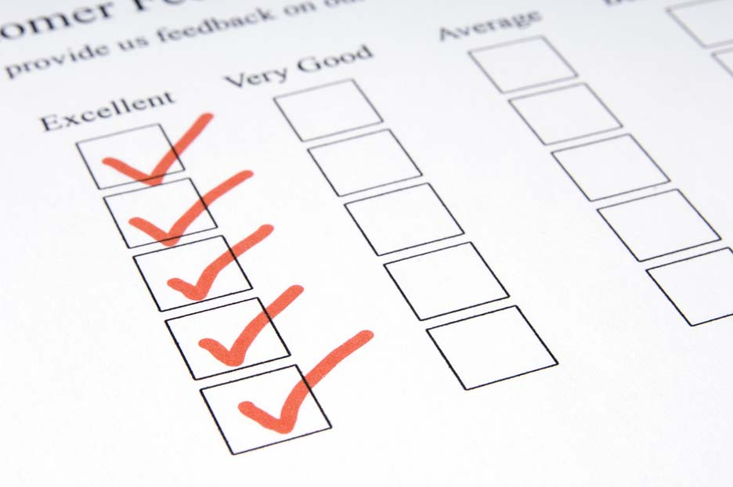
Technique 3: Questionnaires
Why bother?
Good for collecting info from large numbers of people
Can be administered remotely
Can also collect attitudes, beliefs, characteristics
What to watch out for?
Bias in sample selection, self-selecting respondents
Sample size (lack of statistical significance)
Open ended questions (difficult to analyze)
Leading questions
Ambiguous questions

Slide 16
Technique 4: Participant Observation
What you’ll do?
Spend time with the subjects (observe how they perform tasks)
Why this is important?
You understand the context for the software.
Reveals information that cannot be acquired by other techniques.
What you have to consider
How much time have you got?
Proper observation must be done to yield good results

Slide 17
Assignment: [ALL]
Answer Online Quiz about Elicitation and Problem Quiz
Watch the videos on Requirements Specification
Learn how to use Version Control tools:
Git
GitHub

Slide 18
Assignment: [ALL except ANA]
Pair Work - Read interview transcript and submit a problem analysis chart next meeting.

Slide 19
Assignment: [PM]
Know your team members. Manage a contact list and identify preferred communication mode (Make this available to every member of the group)

Slide 20
Assignment: [ANA]
Client Interview Transcript
Draft Problem Analysis Chart
Send on or before Jan. 27, 3PM

Slide 21
Assignment: [DEV]
Define Coding Standards for the team (based on unmaintainable code article)

Slide 22
Assignment: [QA]
Find materials using any of the following keywords:
Software Requirements Specification (SRS) review
SRS walkthrough
Read this material as a preliminary step in determining how you will check and report any defects in your team’s SRS document.

Slide 23
Seatwork:
Go to your project groups.
Write a requirements elicitation strategy plan for your project.
Identify the techniques you’ll be using.
Be specific on who you will interview, what documents will you be looking at.
Review your interview questions.

